Slide 1

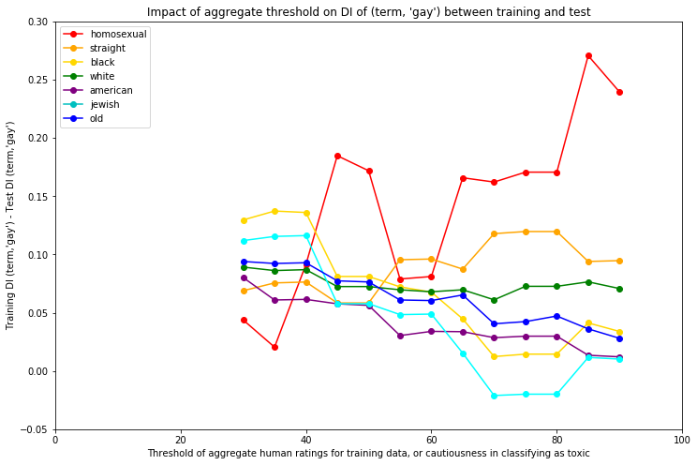
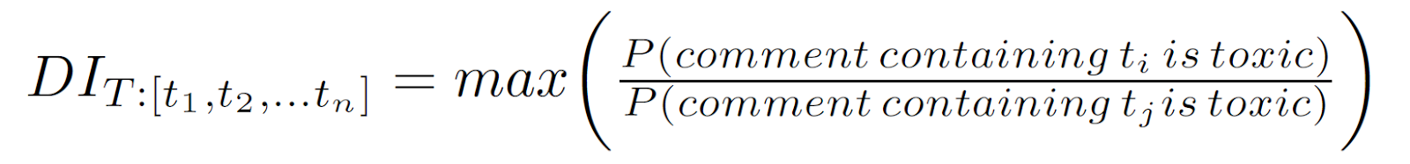
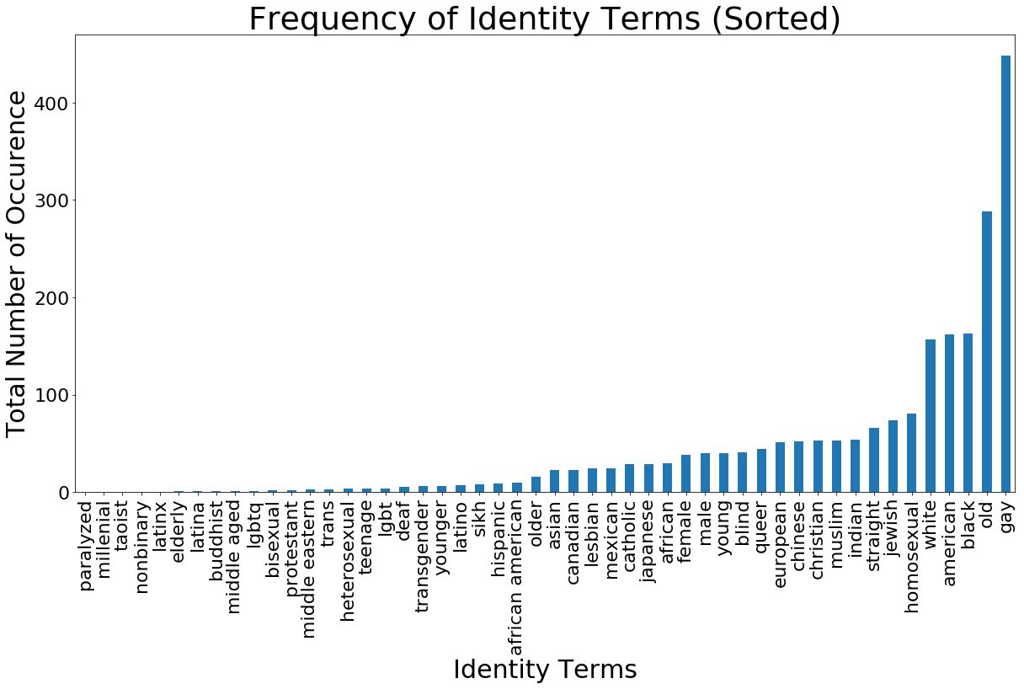

Analysis of toxic comment classification in perturbed text data sets
Neha Gupta, Yujing Ke, Neil Pruthi, Brandon Fain, Ashwin Machanavajjhala
Motivation
Leaving comments online is easy, yet ensuring user comments are appropriate can be difficult. The threat of negative online behavior can drive away users. A website may want to deploy a classifier to automatically flag comments that are mean, hateful, prejudiced, offense, or some combination thereof. However, a classifier may exhibit bias and lead to unfairness because it may predict, correctly or incorrectly, a toxic label for comments about a particular demographic group more often than comments about other demographic groups. In this project, we are interested in the question of how different levels of dataset bias affect the bias of a classifier trained on that dataset. We will tackle this question by perturbing the dataset in a number of ways and observing the resulting changes in fairness of classified data.
Method (continued)
Perturbing our training data
To introduce noise into our training data, we randomly select comments with some probability p, and for those comments, we assign a random toxicity value of either [0,1].
Our measure of bias in data is disparate impact, generalized from its typical two-class definition, as we have more than two demographic identity groups. Intuitively, a high value of disparate impact means that comments containing an identity term t₁ are more likely to be labeled as toxic than comments containing an identity term t₂. We compute the pairwise disparate impact for each pair of terms and then take the max:
Figure 2 shows disparate impact of both our training and test data.
Altering the threshold above which the average of human toxicity ratings must be for a comment to be labeled as toxic
Our original dataset of crowdsourced comment toxicity ratings has around ten human raters for each comment. [cite] labels a comment as toxic if the mean of its toxicity ratings is greater than or equal to 0.5. We adjust this threshold and observe changes in the disparate impact by comparing the demographic identity term gay with seven other identity terms, as shown in Figure 3. We choose the identity term gay because it appears in comments labeled toxic more than any other identity term (see Figure 1).
Conclusion
Mauris orci mi, varius id diam id, egestas auctor enim. Praesent ut massa nibh. Duis purus neque, facilisis cursus ultrices vel, ullamcorper ac augue. Donec semper lorem:
Sed Risus Nibh: CiIn nisl quam, aliquet sed nibh sitamet, faucibus placerat dui augue scelerisque.
Curabitur Accumsan Nulla: Fusce quis augue urna scelerisque, luctus rum sed, ut dolor in pulvinar in eros.
Elementum Orci Dignissim: Proin semper ipsum finibus quam tempor, vitae consectetur.
Methods
We have a dataset of ~128,000 Wikipedia Talk Page comments. We used a logistic regression classifier to predict whether a comment is toxic or non-toxic. In order to ensure we have sufficient sample sizes for each identity term, we only show results for demographic identity terms that appear in at least 3% of comments with identity terms. Figure 1 shows the identity terms, in set T, that met our threshold.
Results
Mauris orci mi, varius id diam id, egestas auctor enim. Praesent ut massa nibh. Duis purus neque, facilisis cursus ultrices vel, ullamcorper ac augue [See Figure A]. Done:
Sed in risus nibh. In nisl quam, aliquet sed nibh sitamet, faucibus placerat dui.
Fusce quis augue scelerisque, luctus rum sed, ut dolor. pulvinar urna in eros posuere.
in elementum orci dignissim. Proin semper ipsum
References
Dixon, Lucas, et al. "Measuring and mitigating unintended bias in text classification." available at: www.aies-conference. com/wp-content/papers/main/AIES_2018_paper_9. pdf (accessed 6 August 2018).[Google Scholar]. 2018.
Wulczyn, Ellery, Nithum Thain, and Lucas Dixon. "Ex machina: Personal attacks seen at scale." Proceedings of the 26th International Conference on World Wide Web. International World Wide Web Conferences Steering Committee, 2017.
Rudinger, Rachel, Chandler May, and Benjamin Van Durme. "Social bias in elicited natural language inferences." Proceedings of the First ACL Workshop on Ethics in Natural Language Processing. 2017.
Bolukbasi, Tolga, et al. "Man is to computer programmer as woman is to homemaker? debiasing word embeddings." Advances in Neural Information Processing Systems. 2016.
Hardt, Moritz, Eric Price, and Nati Srebro. "Equality of opportunity in supervised learning." Advances in neural information processing systems. 2016.
Kusner, Matt J et al. “Counterfactual Fairness.” available at http://papers.nips.cc/paper/6995-counterfactual-fairness.pdf (accessed 26 Nov 2018). 2018
Department of Computer Science Duke University
cs.duke.edu
Mauris orci mi, varius id diam id, egestas auctor enim.

